Slide 1


KBTU
Neural
Network Visualization
september, 2022
september, 2022
Bakyt Kurmanov

Slide 2



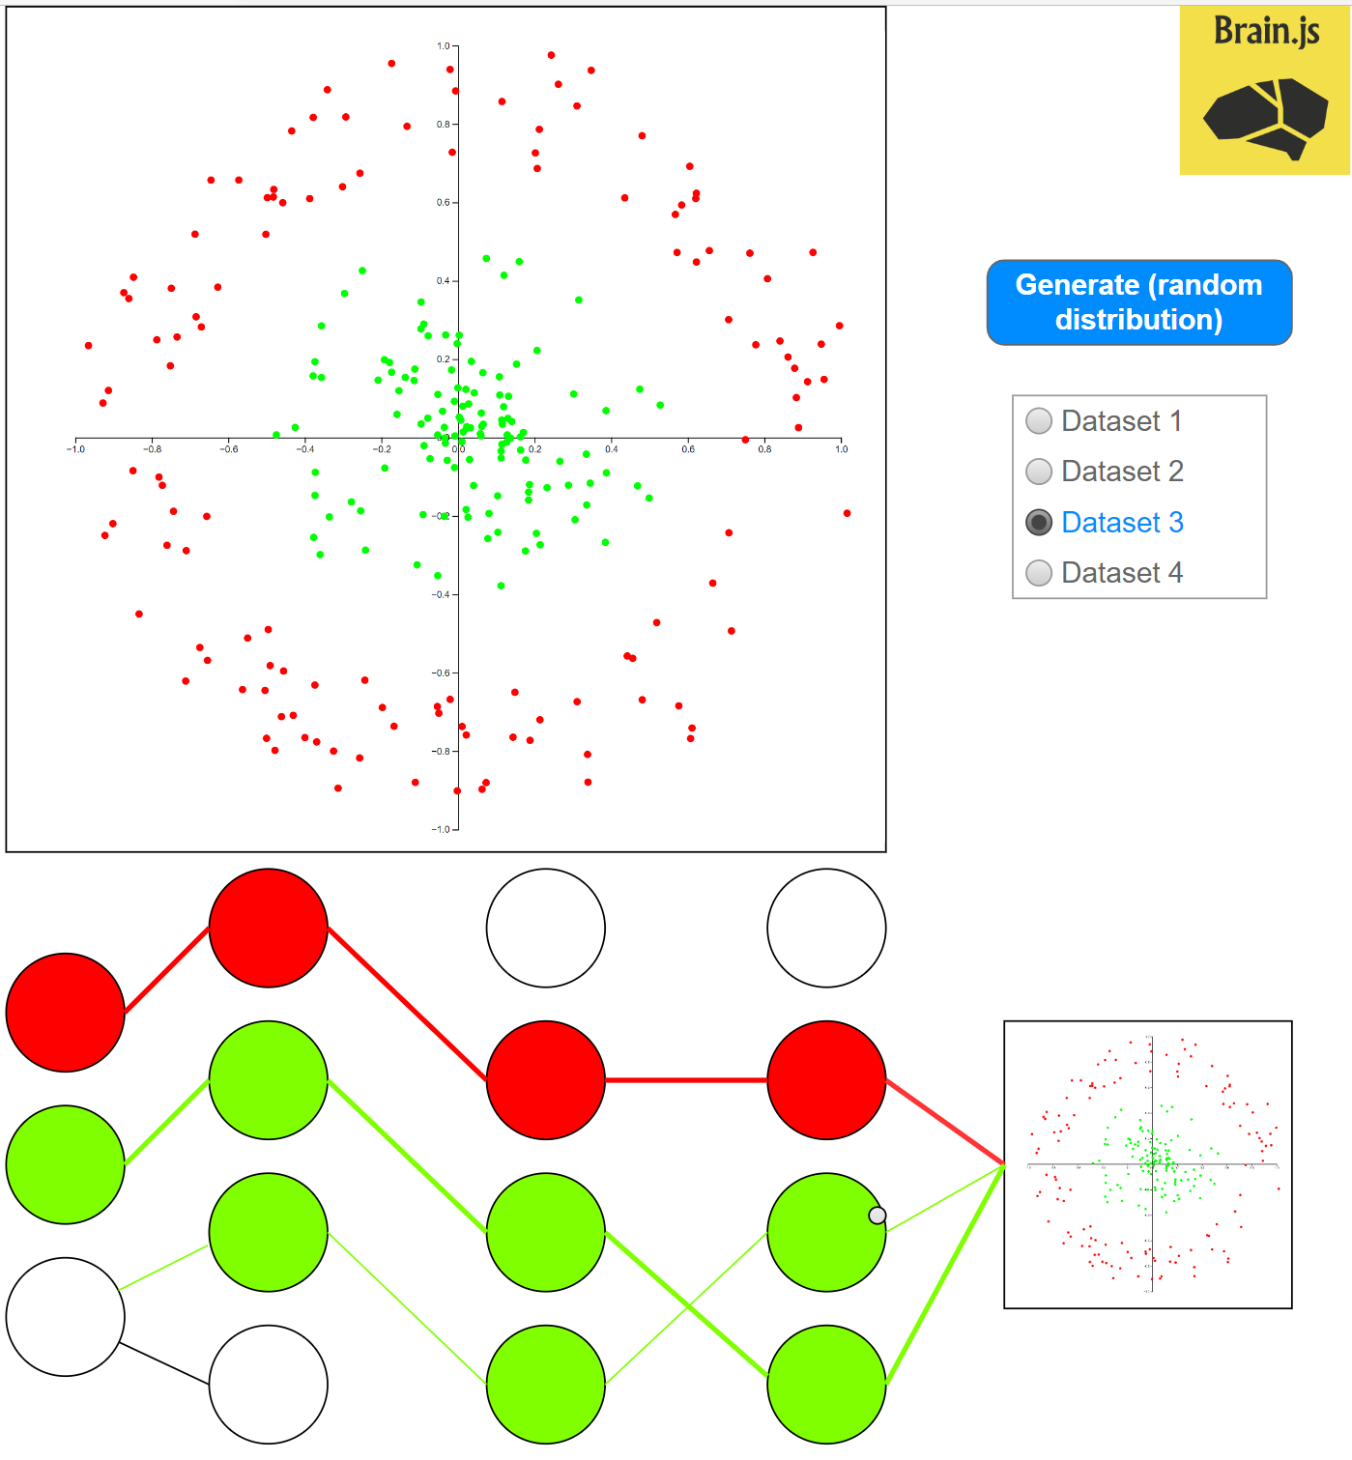
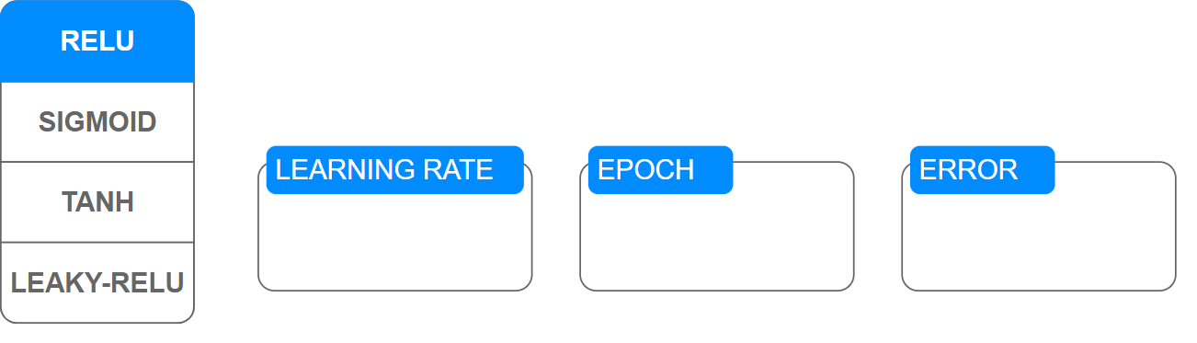

Project mockup
Should be animated:
“Axons”
Input and output layers
Hidden layers
“Dots” classification process
Simple dashboard and controls
№
2

Slide 3
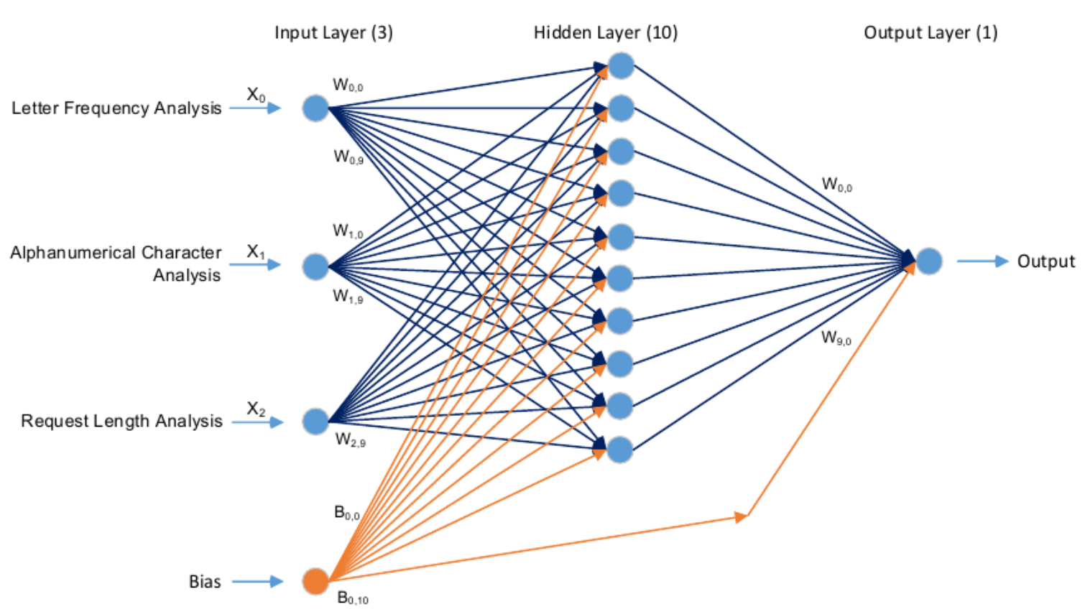
Visualization of neural network model
№
DESIGN AND IMPLEMENTATION OF AN ARTIFICIAL INTELLIGENCE-BASED WEB APPLICATION FIREWALL MODEL
Article in “Neural Network World”, January 2019
3

Slide 4
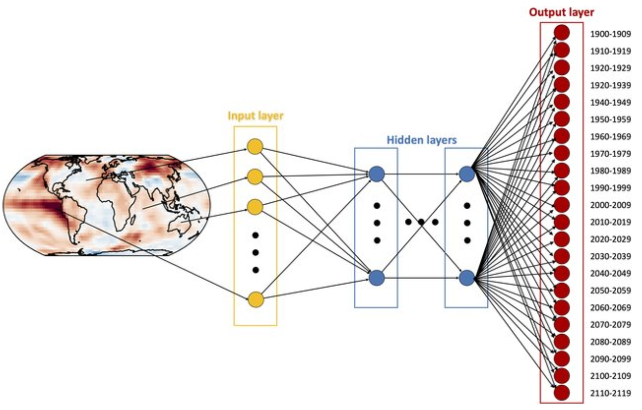
Visualization of neural network model
№
Indicator Patterns of Forced Change Learned by an Artificial Neural Network
Journal of Advances in Modeling Earth Systems, September 2020
4

Slide 5
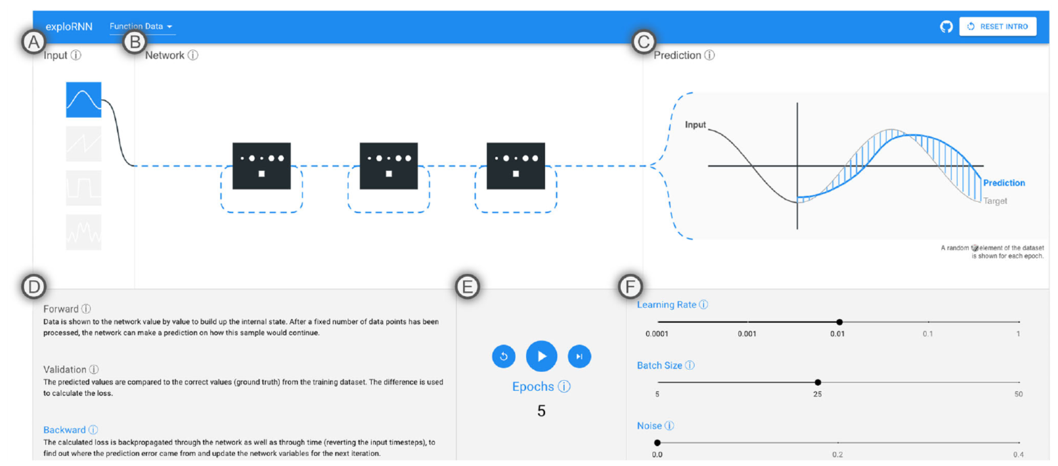
Visualization of neural network model
№
teaching recurrent neural networks through visual exploration
Article in “The Visual Computer”, July 2022
5

Slide 6
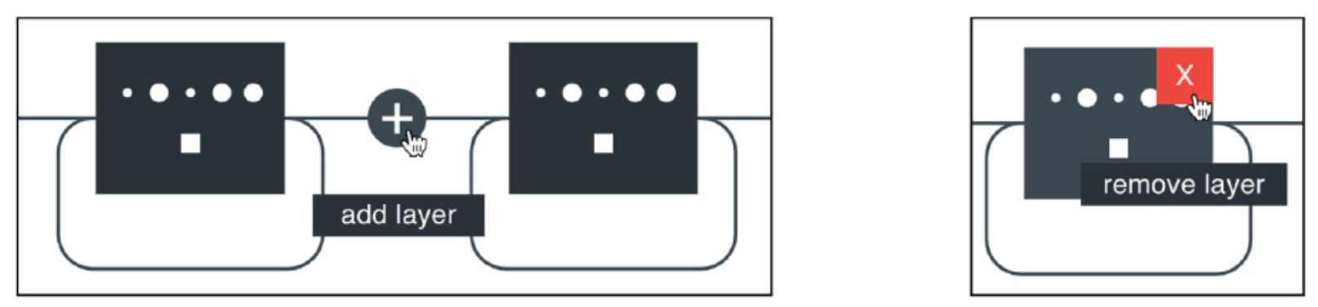
Visualization of neural network model
№
teaching recurrent neural networks through visual exploration
Article in “The Visual Computer”, July 2022
6

Slide 7
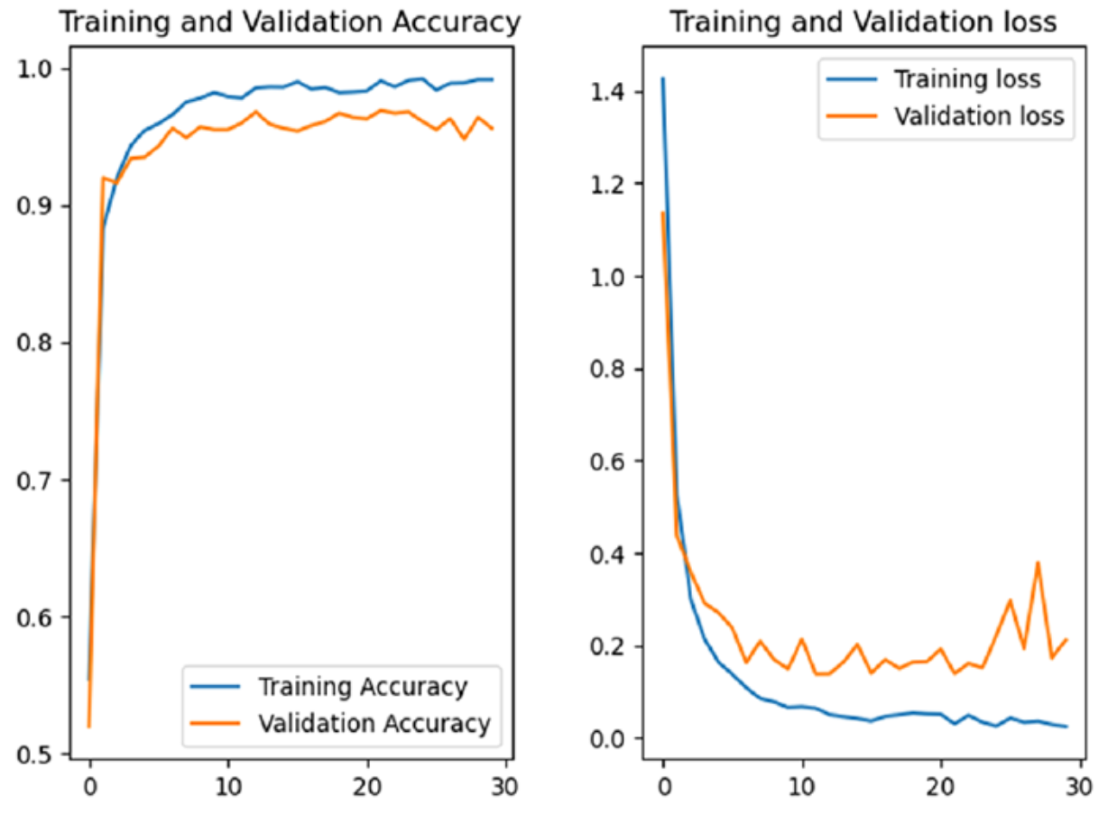
Visualization of neural network model
№
Deep residual neural-network-based robot joint fault diagnosis method
Article in “Scientific Reports”, October 2022
7

